Slide 1
천안 순천향대학병원
SCM – USM – LGM Serial Number

Slide 2
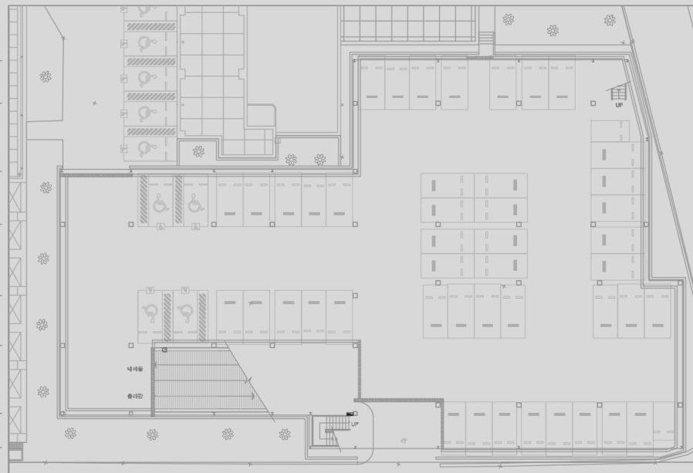
[ USM Serial Number ]
SCM 1
9428
9431
9432
9434
USM 9421 ~ 9471 (51)
9435
9461
9460
9421
9423
9425
9427
9439
9464
9457
9440
9471
9468
9465
9453
9456
9441
9443
9452
9450
9447
9444

Slide 3
[ LGM Serial Number ]
SCM 1
2841
2842
LGM 2838 ~ 2854 (17)
2843
2851
2850
2838
2839
2840
2844
2854
2853
2852
2849
2845
2848
2847
2846

Slide 4
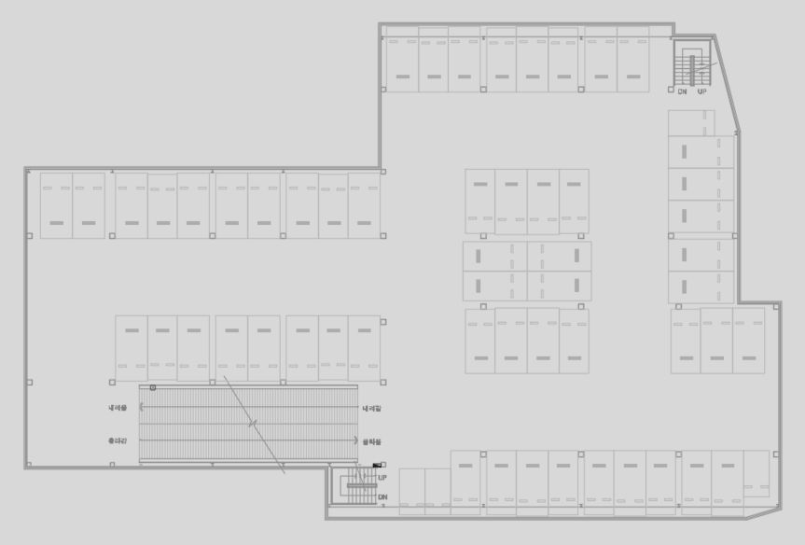
[ LGM Serial Number ]
SCM 2
9482
9485
9489
9490
USM 9472 ~ 9530 (59)
9472
9474
9477
9481
9520
9517
9521
9516
9494
9522
9515
9495
9530
9528
9526
9523
9511
9514
9496
9498
9510
9508
9505
9502
9499

Slide 5
[ LGM Serial Number ]
SCM 2
3222
3223
3224
LGM 2855 ~ 2857 (3)
3221 ~ 3238 (18)
3234
3225
2855
2856
2857
3221
3235
3233
3226
3238
3237
3236
3232
3227
3231
3230
3229
3228

Slide 6
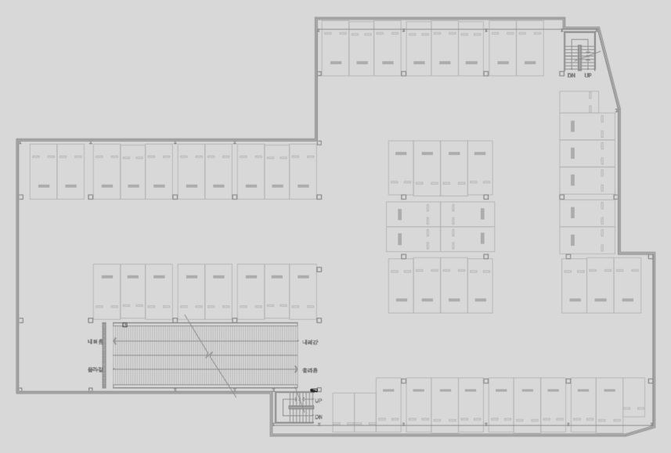
[ LGM Serial Number ]
SCM 3
9541
9544
9548
USM 9531 ~ 9589 (59)
9549
9531
9533
9536
9540
9579
9576
9552
9580
9575
9581
9574
9554
9589
9585
9582
9570
9573
9555
9557
9569
9567
9564
9561
9558

Slide 7
[ LGM Serial Number ]
SCM 3
3243
3244
3245
LGM 3239 ~ 3259 (21)
3255
3246
3239
3240
3241
3242
3256
3254
3247
3259
3258
3257
3253
3248
3252
3251
3250
3249

Slide 8
전광판
<-<-
1F
2F
1층
2F
23
4F
<-<-
2F
3F
2층
3F
33
3F
<-<-
3F
4F
2F
3층
4F
25
1F

Slide 9
2F
23

